Slide 1
Building an IO Service
Dr Anna Olsson-Brown
Medical Oncology Consultant
Clinical Director and Immunotherapy Lead
Clatterbridge Cancer Centre

Slide 2
Initial Questions
What is the scale of the issue ?
Where are the main pinch points?
What resources are we currently using?
What can we implement easily?
What reorganisation can we do?
What do we want the ‘service’ to look like?
What do we need to achieve it?
How do we balance cost and demand?
What outcomes can we achieve?

Slide 3
What is the scale of the issue ?

Slide 4
background

Slide 5
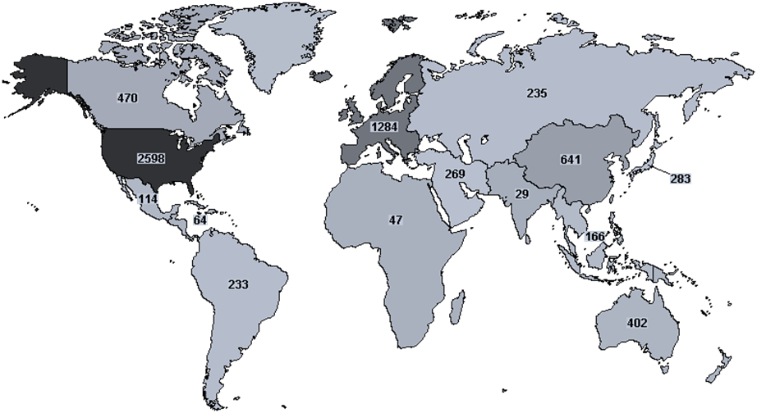
Oncological Immune Checkpoint Inhibitors

Slide 6
ICI Immuno-therapy
Melanoma
Lung
NSCLC
SCLC
Renal Cell Carcinoma
Bladder/ GU
Head and neck
Hodgkin Lymphoma
Merkel Cell
Upper GI
Triple Negative Breast Cancer
HCC
Skin Squamous Cell
Gynaecological
Colorectal (MSI high)
Mesothelioma

Slide 7
Monotherapy
Metastatic Disease 1st line 2nd line 3rd line and beyond
Combination Therapy
Metastatic Disease 1st line 2nd line
Monotherapy
Maintenance Locally Advanced Following Chemo-
radiotherapy
Monotherapy
Adjuvant (increasingly earlier stage)
Combination Therapy
Neoadjuvant
Adjuvant

Slide 8
A Wide Field
Immunotherapy
Monoclonal Antibodies
Oncolytic virus therapy
T-Cell therapy
Cancer vaccines
Non-specific immunotherapy
Checkpoint inhibitors
Interferons
αCTLA4
Interleukins
αPD1
αPD L1

Slide 9
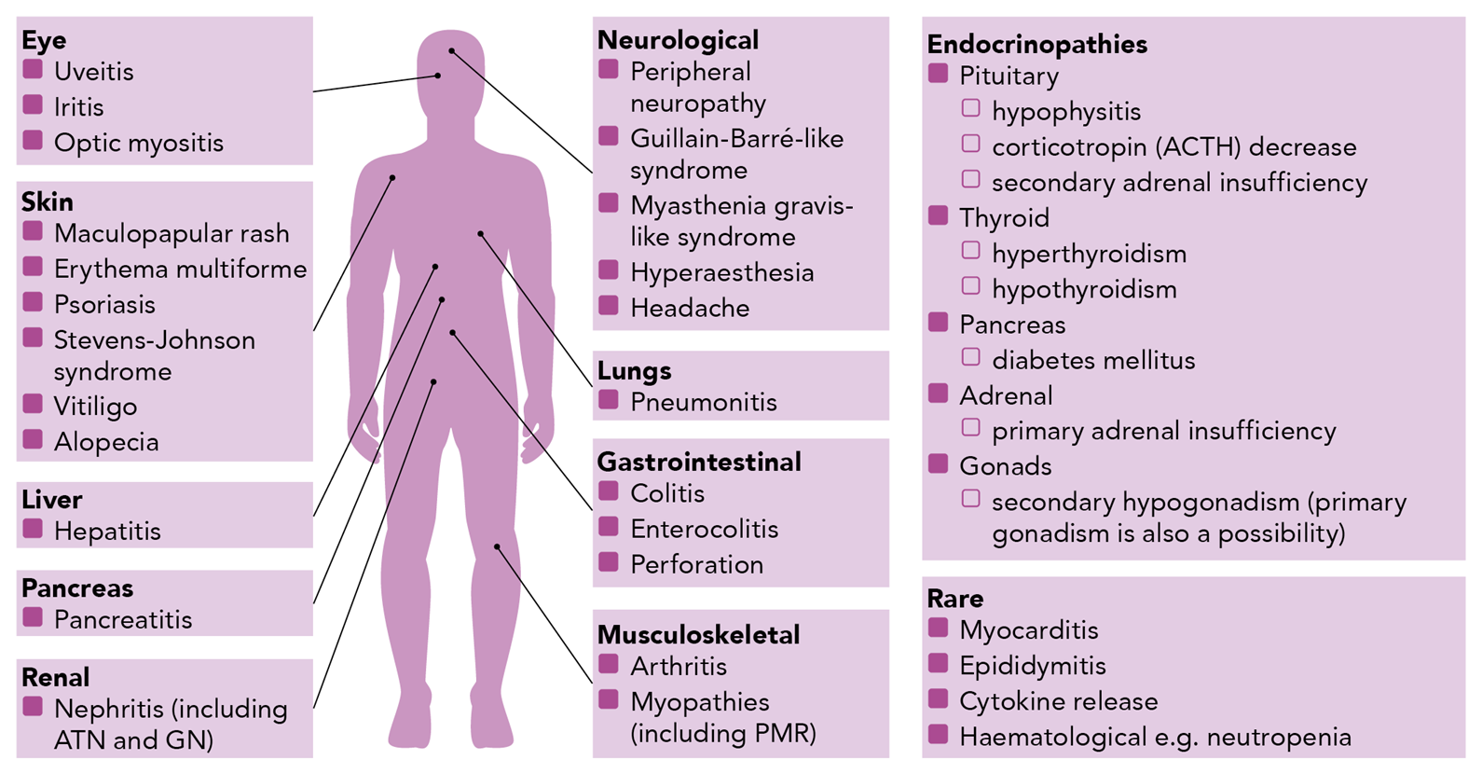
Immune-Related Adverse Events (irAEs)
Grade 3-4 Reactions:
CTLA-4 27%¹
PD-1/PDL-1 up to 19%¹
Combination treatment (CTLA-4 and PD-1/PDL-1) up to 58%¹
The data on this slide is taken from clinical trials.
irAE = immune-related adverse event; DRESS = Drug reaction with eosinophilia and systemic symptoms; GI = gastrointestinal.
1. Olsson-Brown, Harker. 2018. Guidelines in Practice. 2. Suarez-Almazor ME, et al. Arthritis Rheumatol. 2017;69:687-699; 3. Cappelli LC, et al. Arthritis Care Res (Hoboken). 2017;69:1751-1763;
4. Cappelli LC, et al. Rheum Dis Clin North Am. 2017; 43:65-78.

Slide 10
What are the main pinch points ?

Slide 11
What is the current model?

Slide 12
What can we implement easily?

Slide 13
What reorganisation can we do?

Slide 14
What do we want the ‘service’ to look like?

Slide 15
What do we need to achieve it?

Slide 16
How do we balance cost and demand?

Slide 17
What outcomes can we achieve?

